Slide 1
CS 4350: Fundamentals of Software Engineering CS 5500: Foundations of Software Engineering Lesson 1.1 Course Introduction
Jon Bell, John T. Boyland, Mitch Wand
Khoury College of Computer Sciences

Slide 2
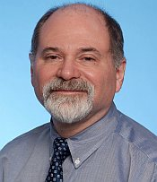

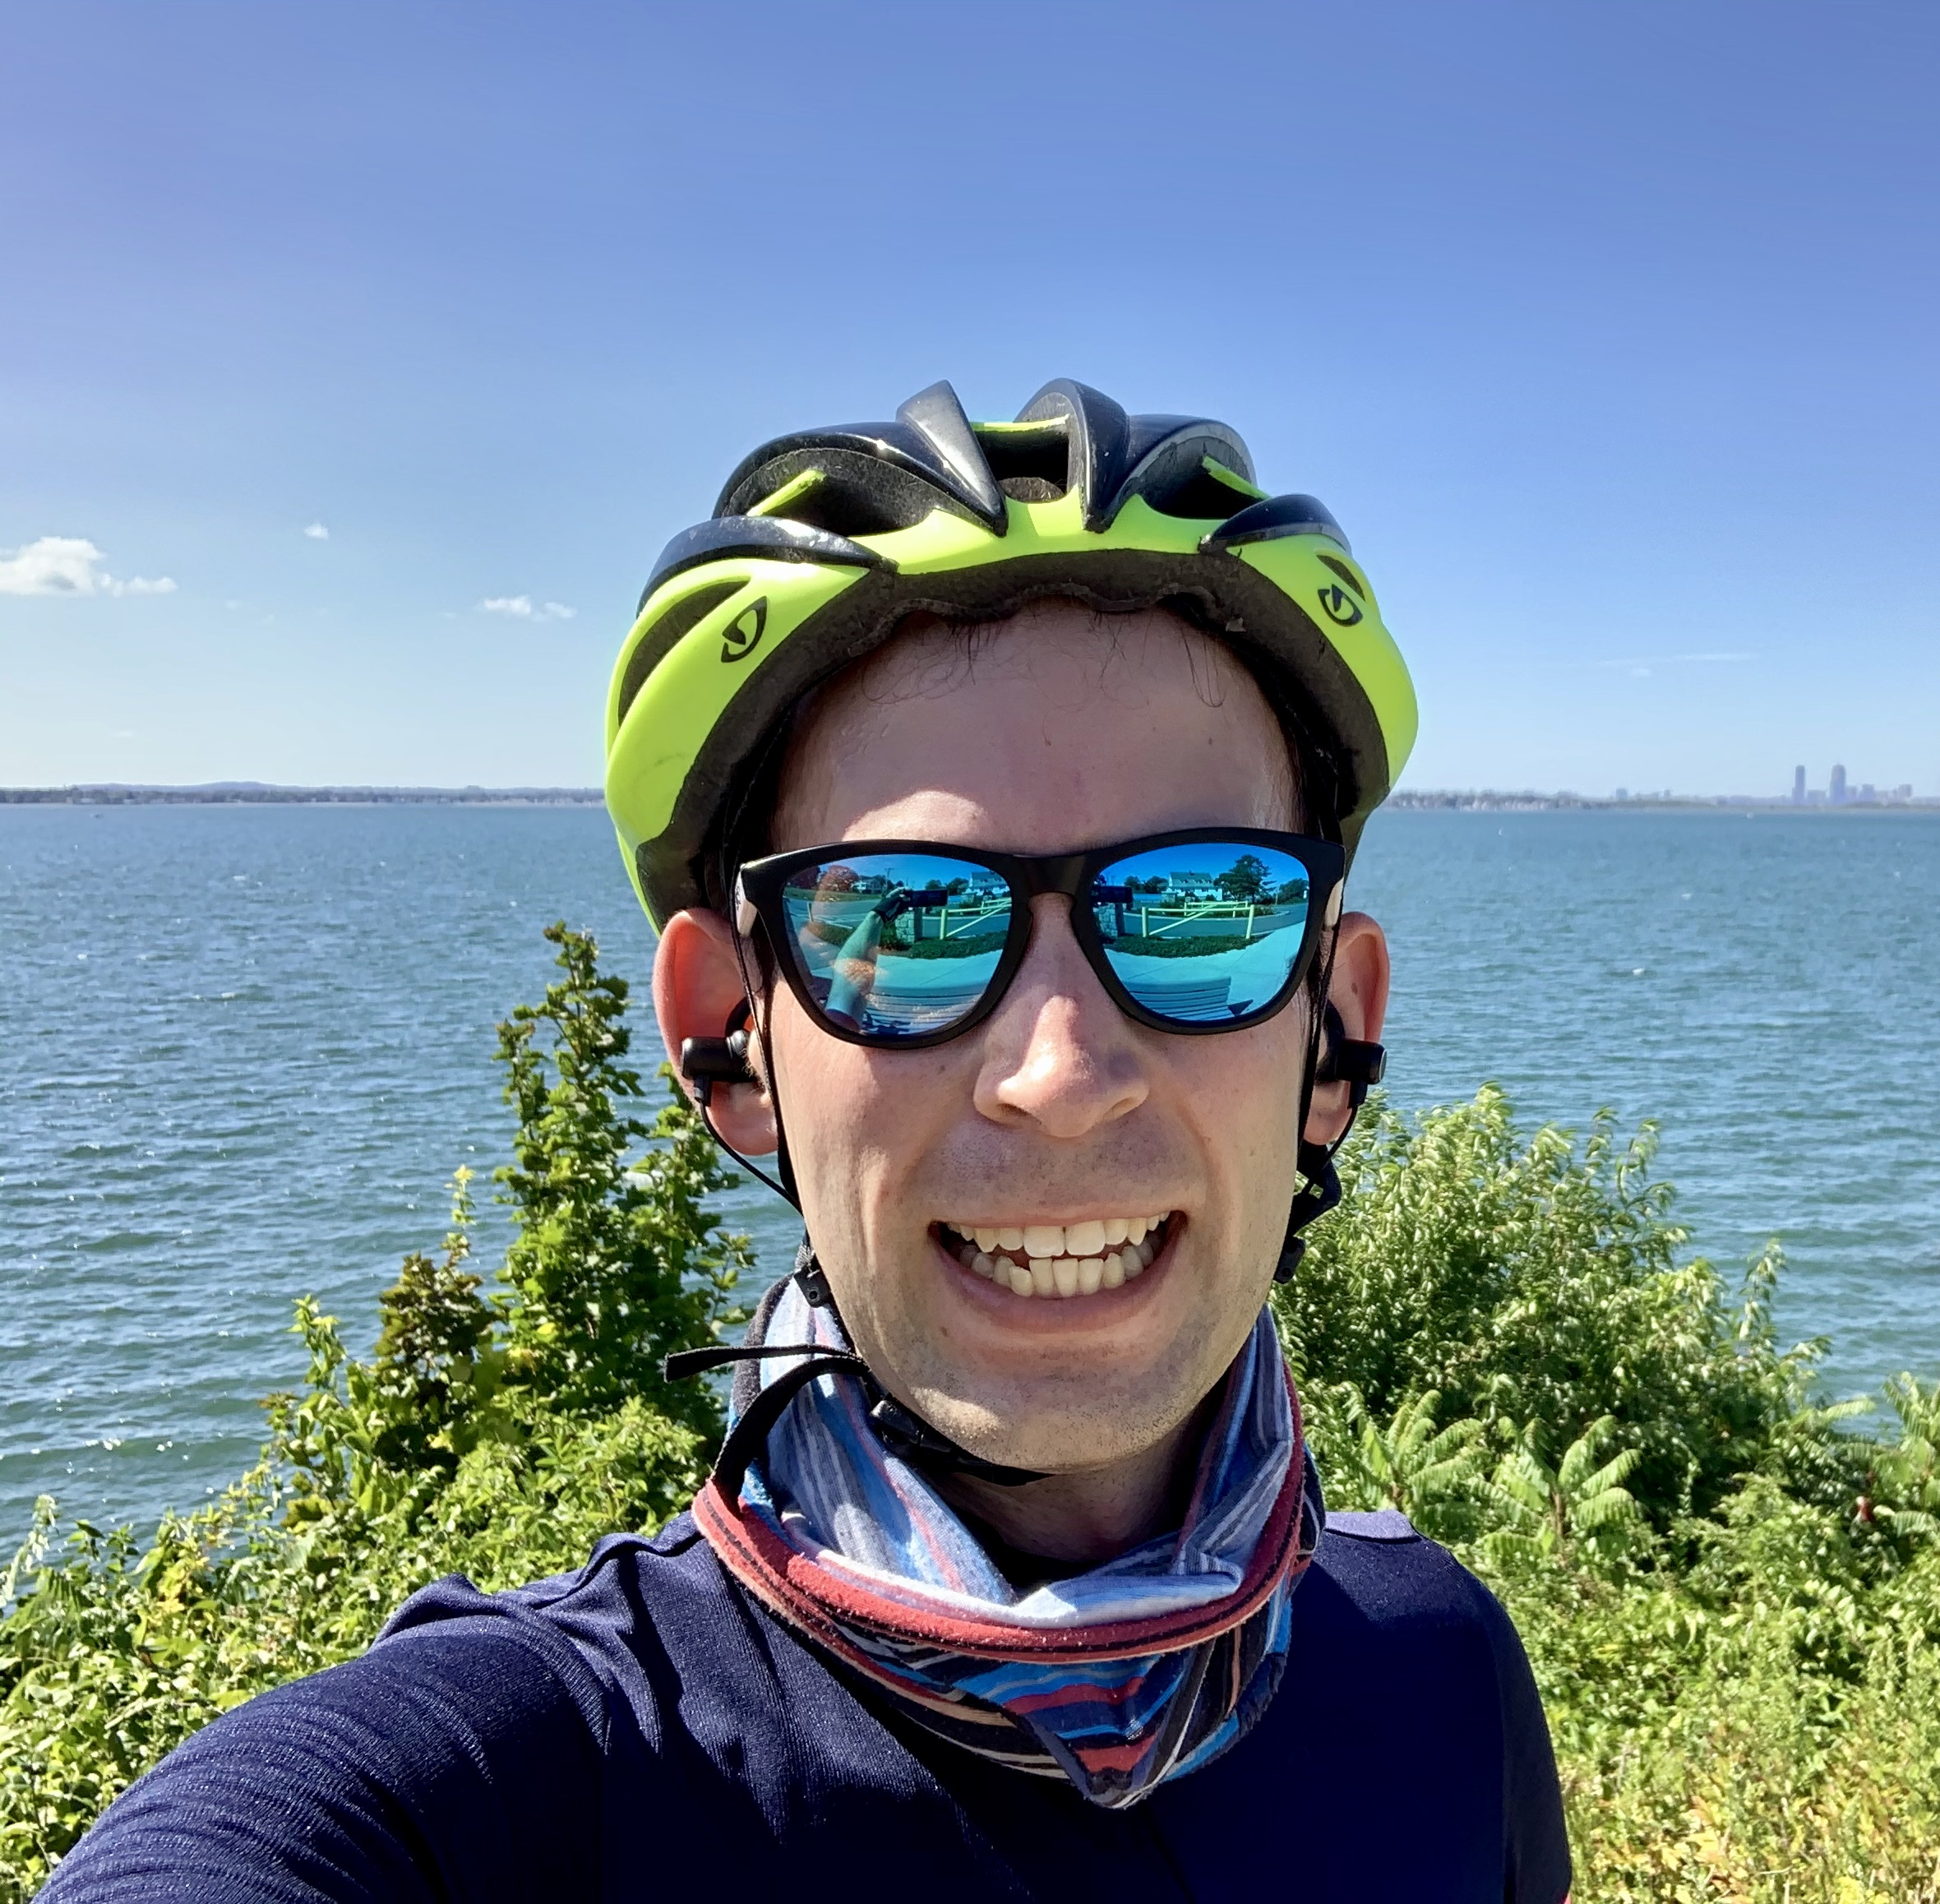
Instructors
Mitch Wand
Frank Tip
Jonathan Bell

Slide 3
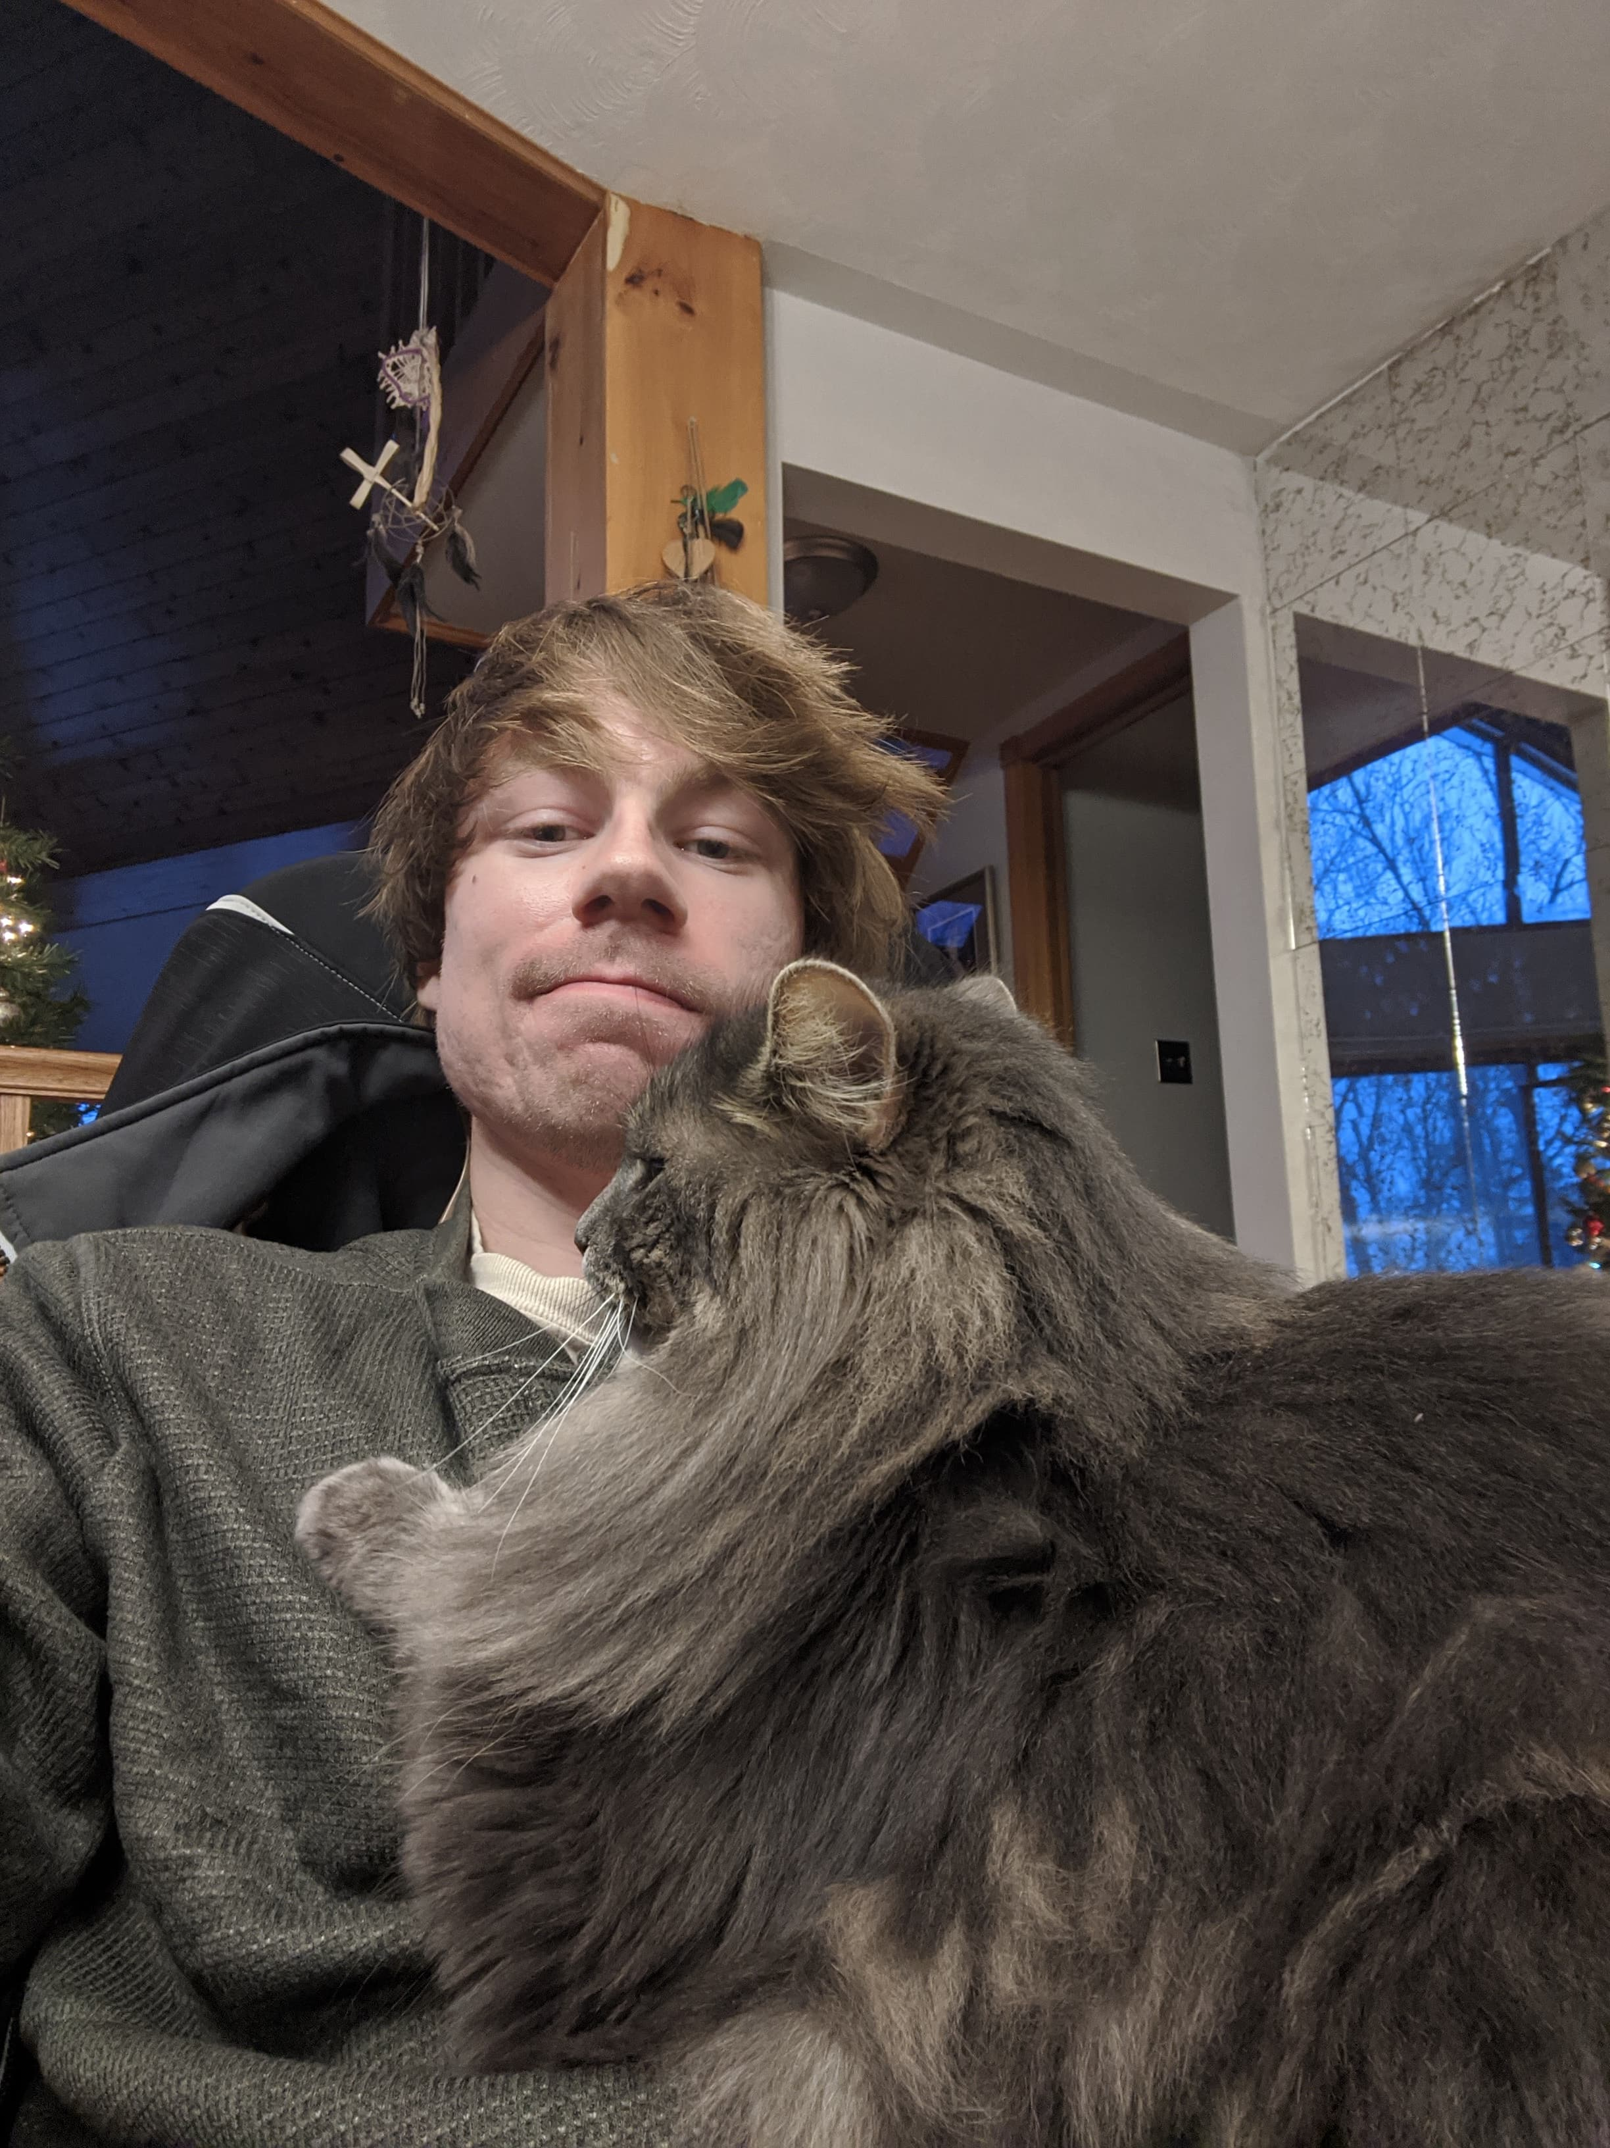
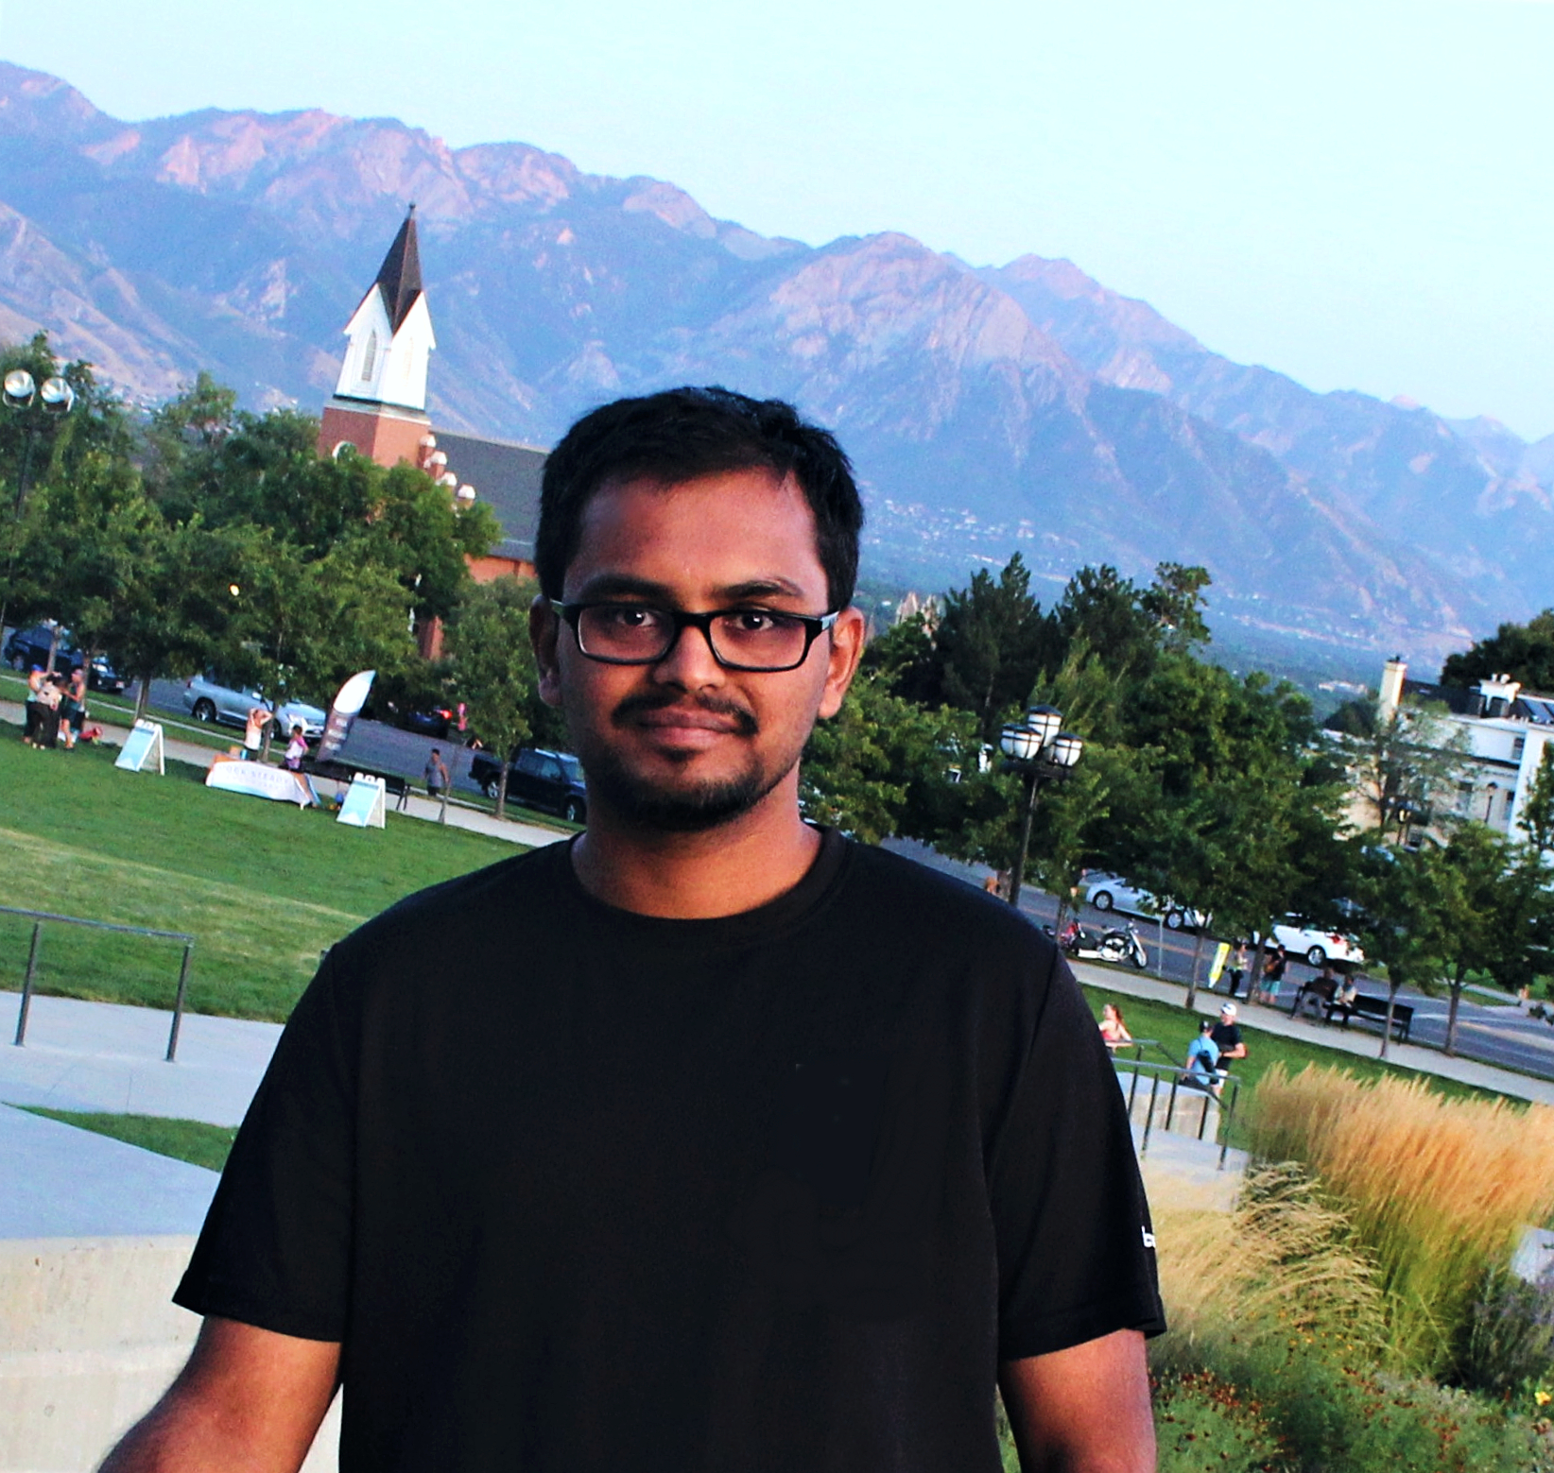
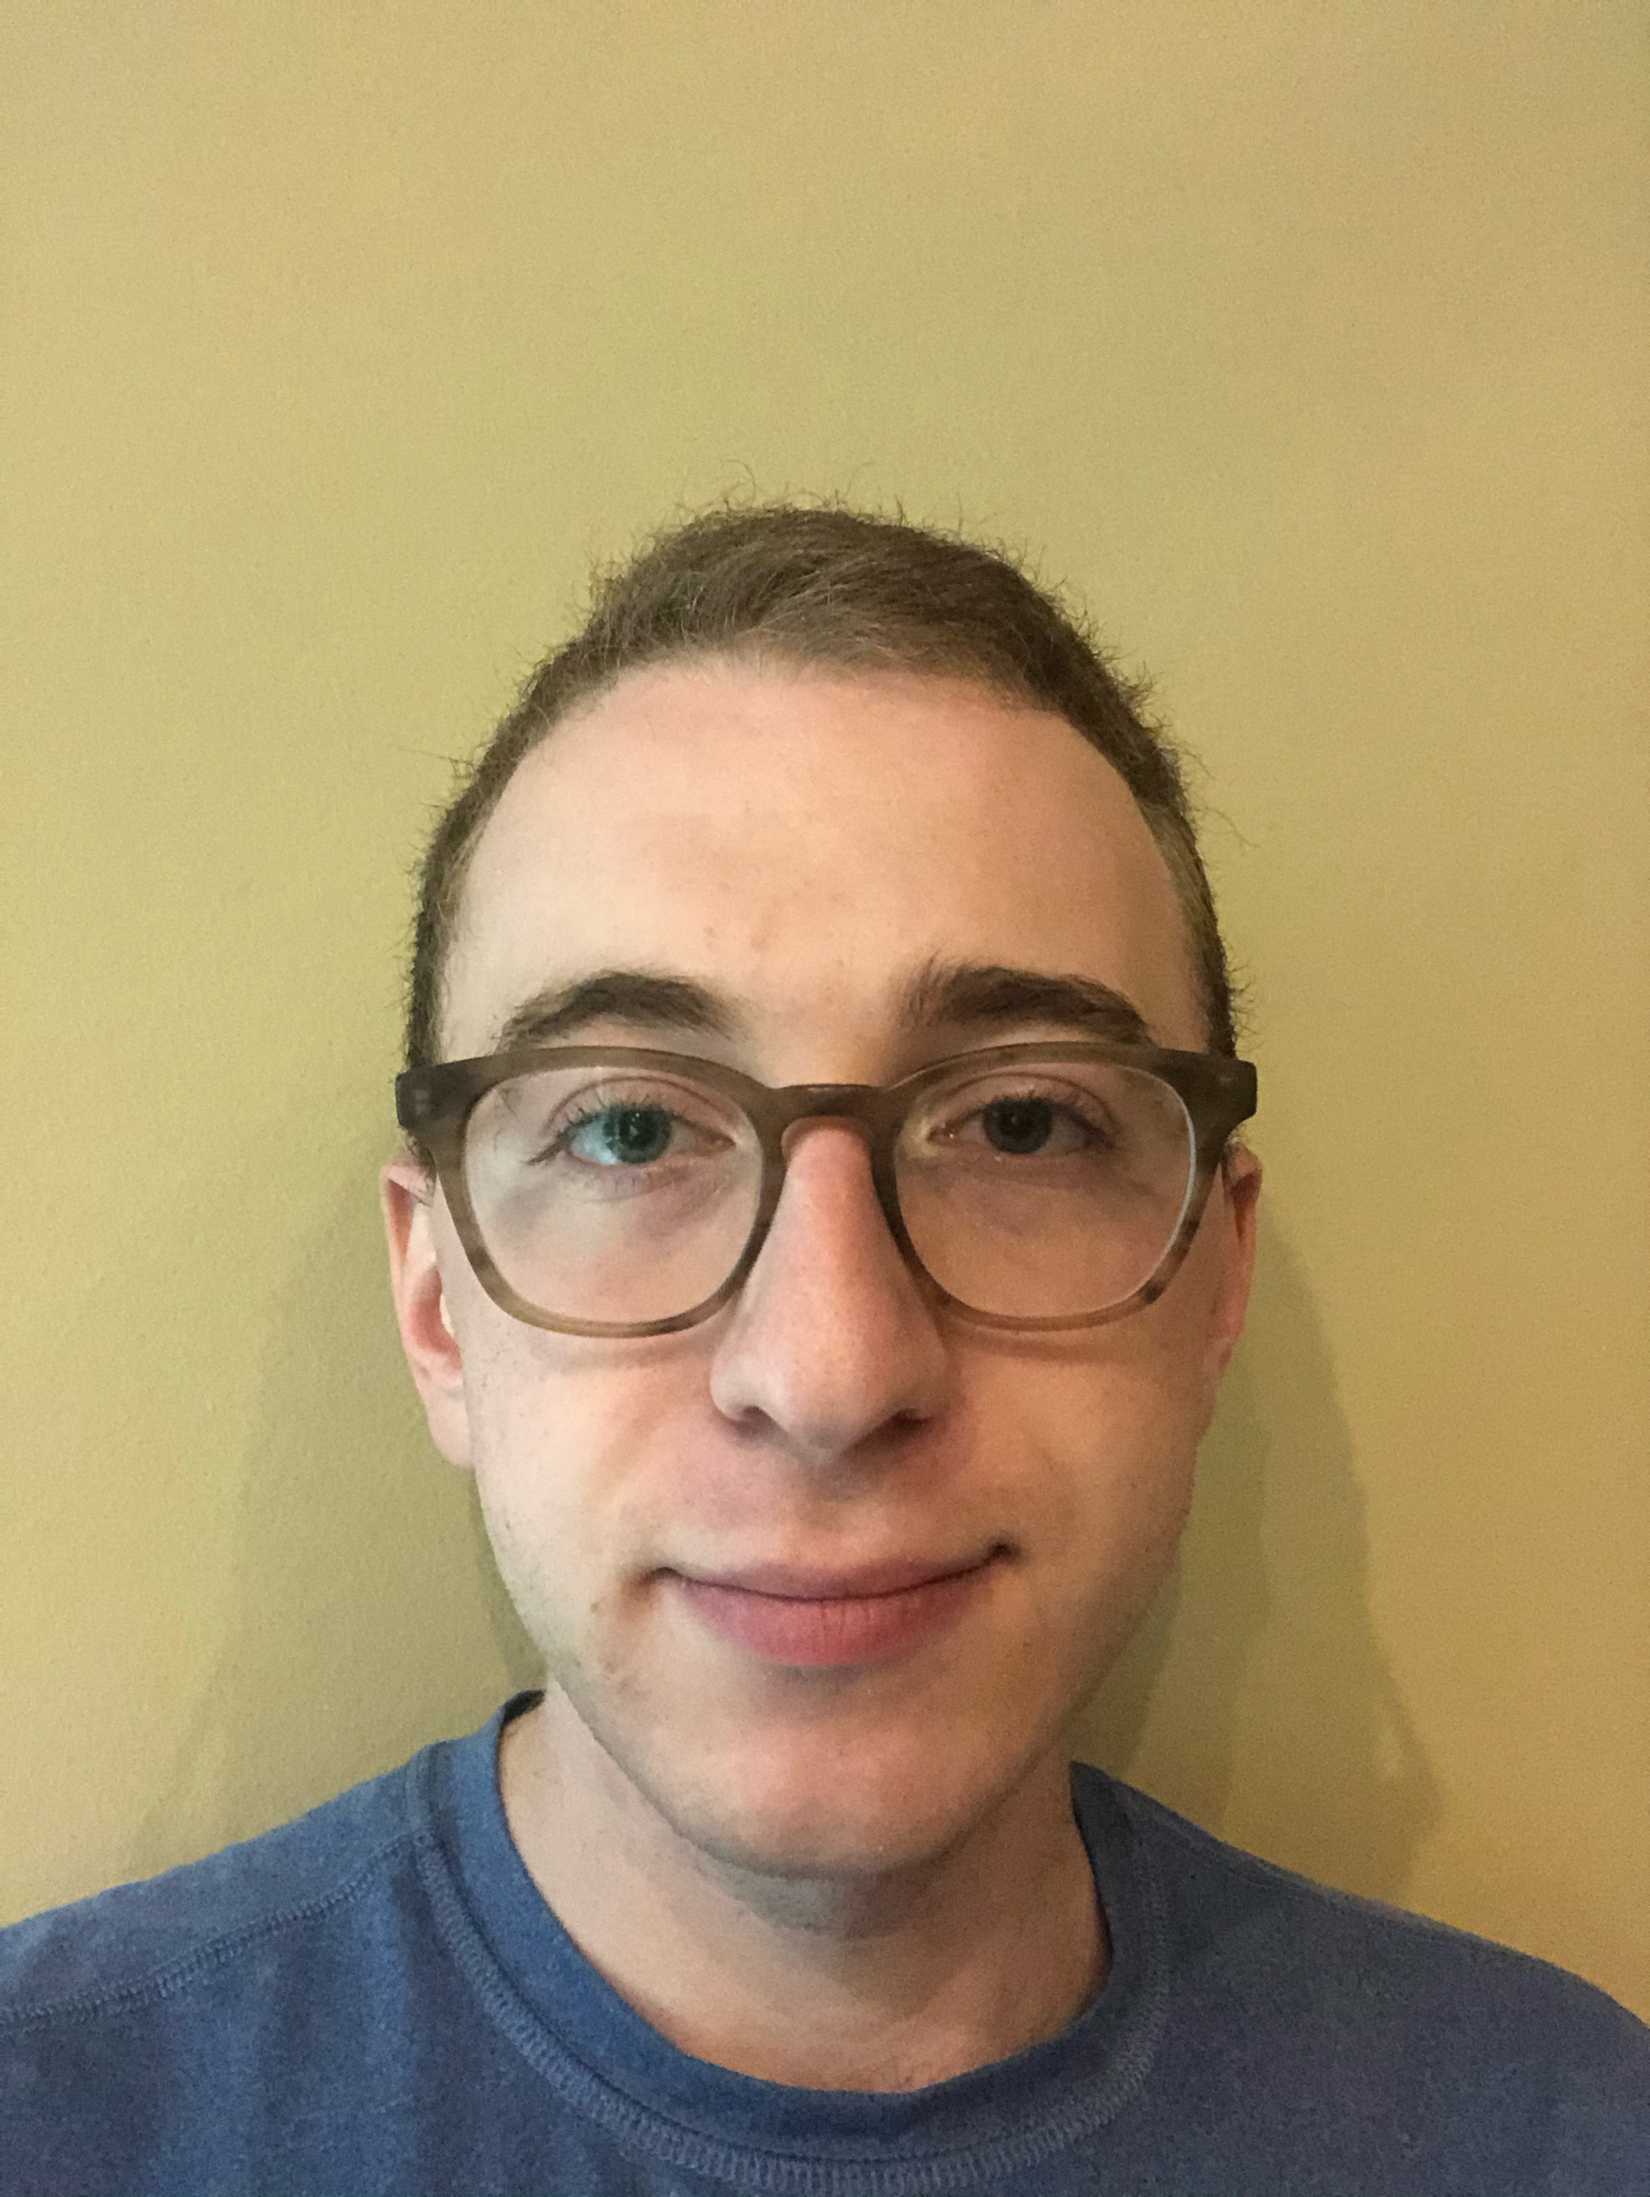
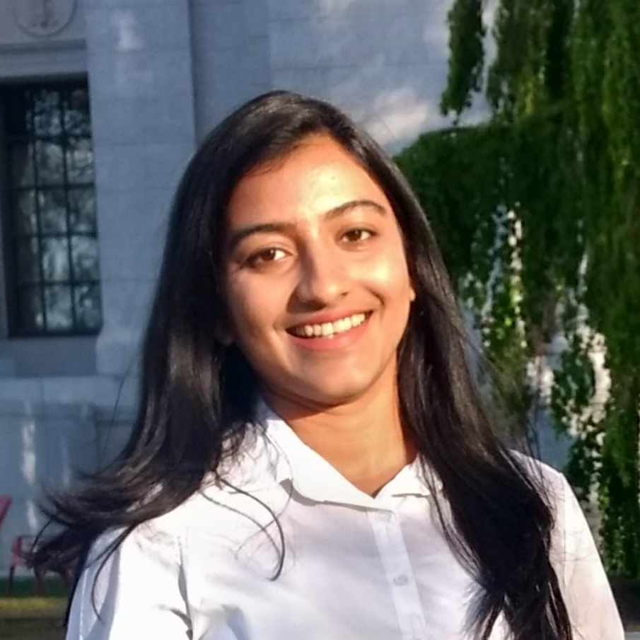
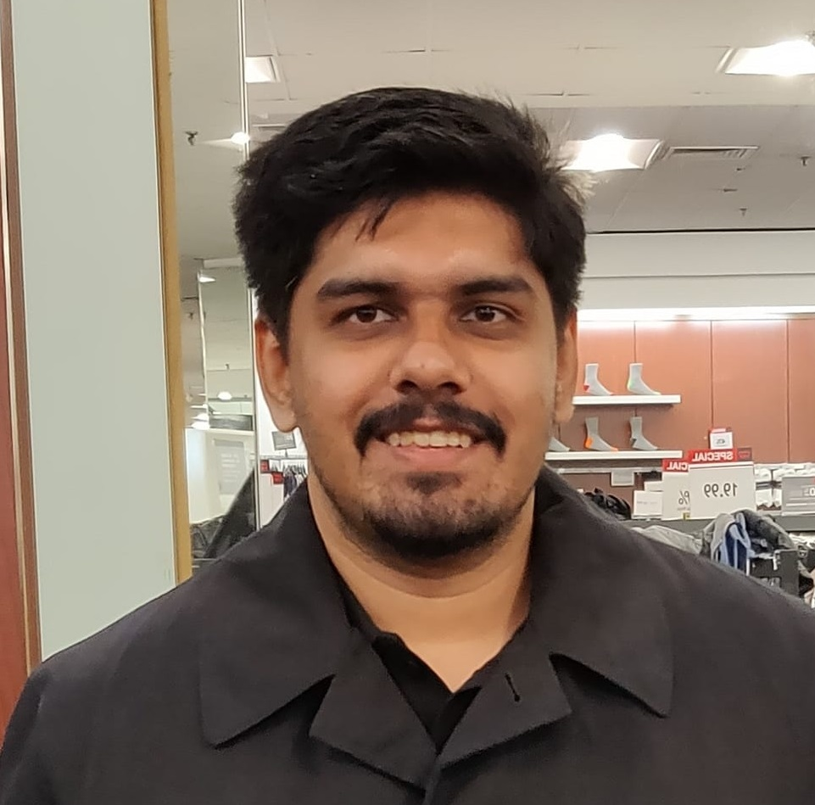

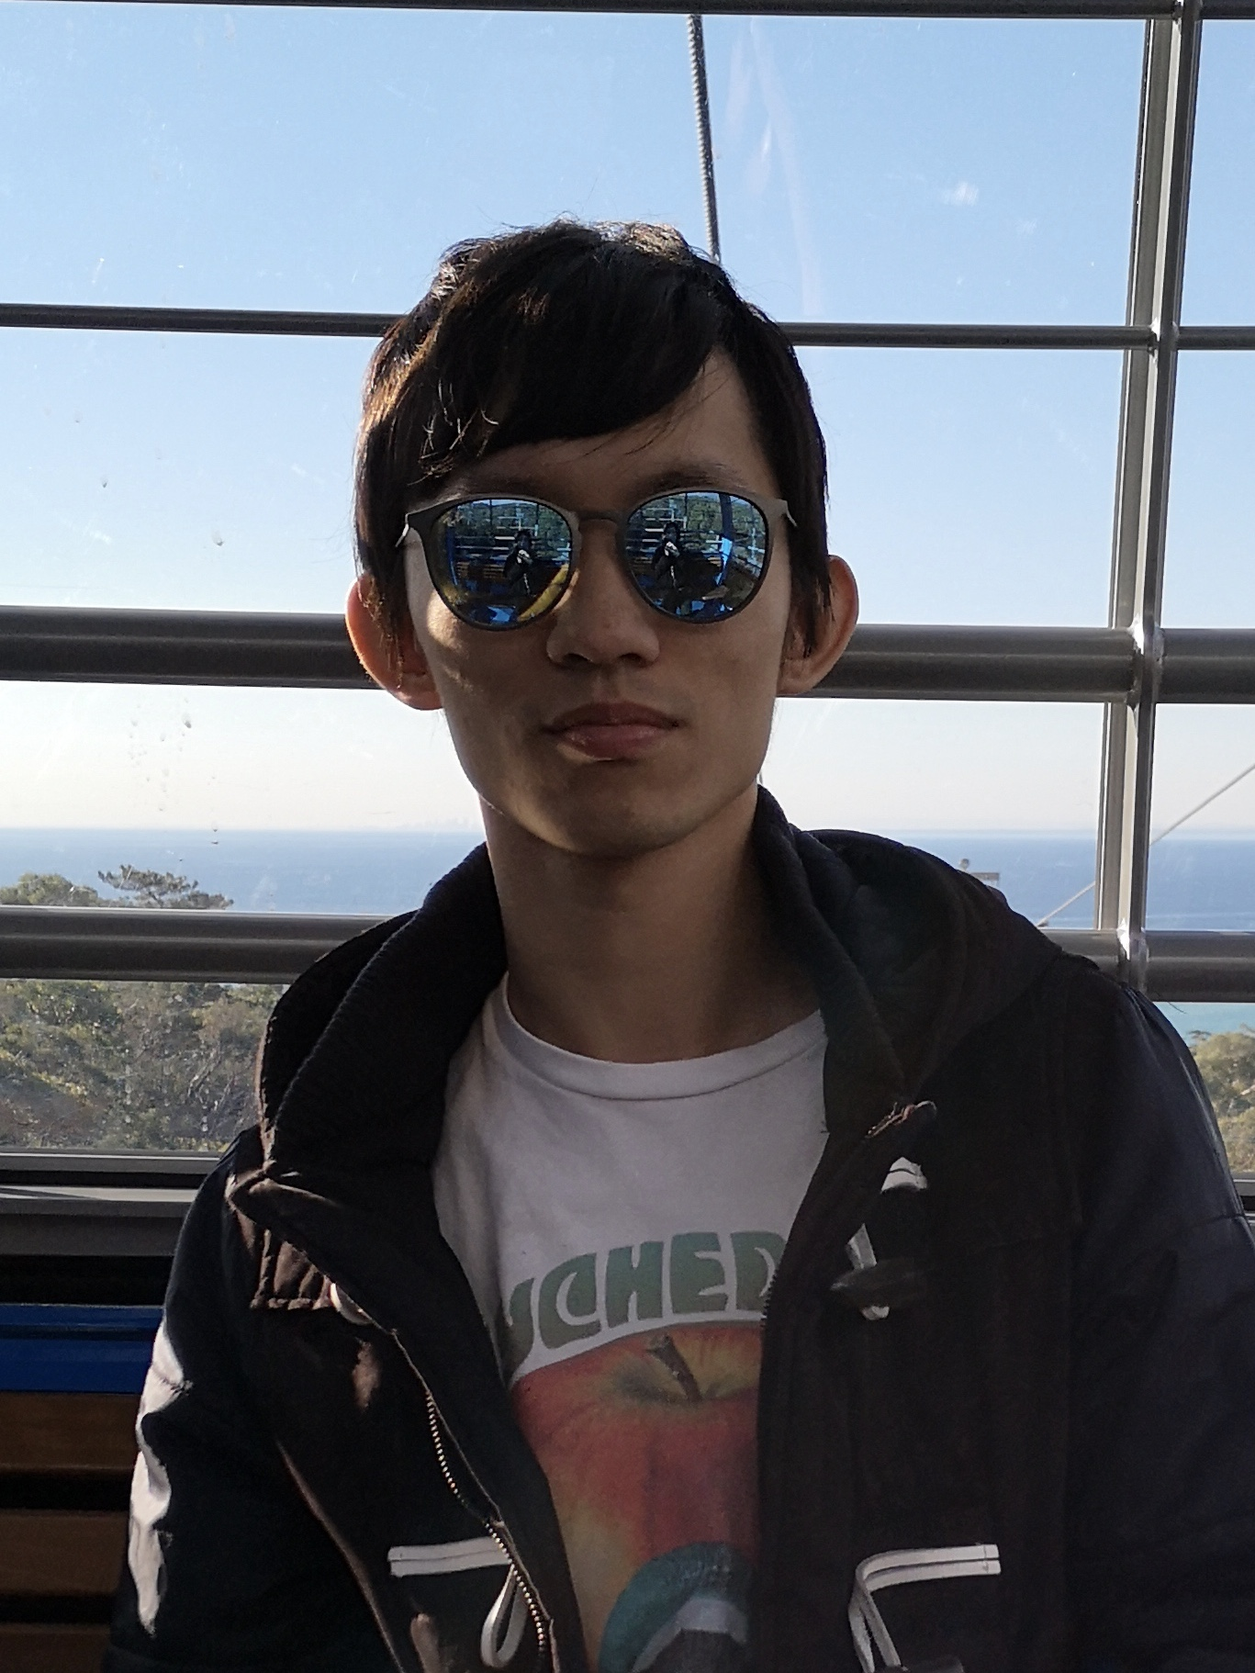
Teaching Assistants
Alexi Turcotte
Rajath Kashyap
Prajakta Rodrigues
Jake Feinbaum
Satyajit Gokhale
Magnus Frennberg
Weijie (Ben) Deng

Slide 4
CS 5500: Course Learning Objectives By the end of this course you will
Be able to define and describe the phases of the software engineering lifecycle.
Be able to explain the role of key processes and technologies in modern software development.
Be able to productively apply instances of major tools used in elementary SE tasks.
Design and implement a portfolio-worthy software engineering project in a small team environment that can beshowcased to recruiters.
Notes:
other factors: careful design, extensible solutions, effective teamwork, etc.

Slide 5
Good code is necessary but not sufficient
Developing software is a systems enterprise
many stakeholders
what are the requirements?
how to organize the code?
how do members of a team work together?
how to test the software?
how to deploy the software?
etc, etc, etc.

Slide 6
Course Mechanics
Our goal is to provide a productive learning environment to both remote and on-the-ground students
“Flipped-Classroom” Model:
Lecture videos will be posted at start of week: watch videos before coming to class
During scheduled class time: discussion, activities. If you come in person, bring laptop and headphones
You are expected to come to class, either in person or remote.

Slide 7
Approach
We will try to mirror the experience of a young software engineer joining a new team...
"onboarding" to a new codebase
start with small individual projects (apx. 4 homeworks)
participate in small team project to design & develop a major new feature (Team Project, with intermediate deliverables)

Slide 8
Course Requirements

Slide 9
Approach
TypeScript as implementation language
React for web UI
Homeworks to reinforce & assess competence in lecture material
Course Project

Slide 10
Late Policy
Your work is late if it is not turned in by the deadline.
Submissions will be accepted up to 48 hours after the deadline with a 50% penalty.
See course web page for details.
Sometimes life gets in the way of schedules. When "life happens," poor planning by you does not count. Do not wait to discuss gray areas: talk to your Instructor ASAP.
DO NOT COME TO CLASS IF YOU ARE SICK

Slide 11
Grade Appeal Policy
scores for homeworks/projects/midterms will be final two weeks after they have been returned to you

Slide 12
Academic Integrity
Individual assignments are just that - work that you do on your own. For example, when you are asked to write a program for an individual homework assignment, you should not discuss your solution with other students. If something is unclear, please ask a TA for clarification.
No illicit collaboration! If unsure, ask the professor!
You must submit only your own work. If you steal someone else's work, you fail the class. If you are in doubt whether using others' work is allowed, you should assume that it is NOT allowed unless the instructors confirm otherwise.
You are responsible for protecting your work. If someone uses your work, you fail the class.
See the course web page for details and examples.

Slide 13
OK, now let’s get down to work!

